Slide 1

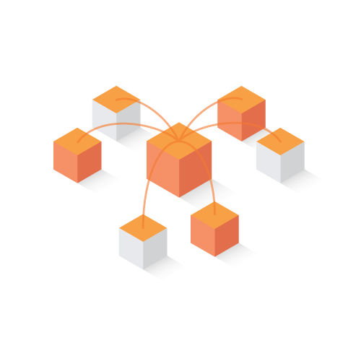
BOOKCHAIN
Presented by Team RW4
for
MachoHack 2018

Slide 2






Team
Wen Xing Pan
Captain & Back-end
Vincy Wang
Front-end
Wilfred Tam
Research
Mimi Vong
Business Analytics

Slide 3
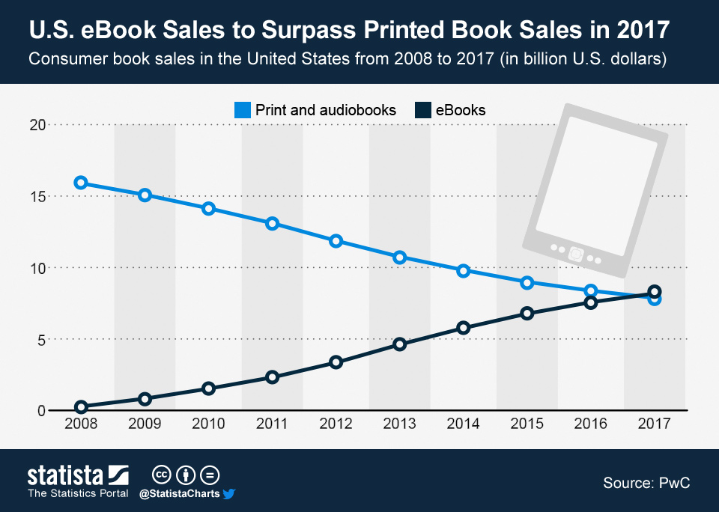
What’s Wrong with Publishing Industry?
Amazon has dramatically disrupted the way readers consume eBooks through Kindle.
However, it has not done much to help authors
U.S. eBook Sales to Surpass Printed Book Sales in 2017
Consumer book sales in the United States from 2008 to 2017 (in USD billions)
Source: PwC

Slide 4
Problems
1. Payment
2. Piracy
3. Centralization
$3 Bil
Estimated Loss of U.S. Market
80%
Market share of publishing controlled by Top 5 publishing houses
Most authors only get 6~10% royalty
Payment Schedule may run up to 1 year
Everyone get paid first before authors
Notes:
Fundamental Issues With Content & Trust
Volume & quality of content
Social platforms and messengers are flooded with unwanted messages and inaccurate or misleading content that lead to faulty decision making.
Maximum # of trusted contacts is limited The Dunbar number says the average person can maintain at most 150 trusted connections, yet today’s world demands interactions well beyond this limit.
Not enough trust online
Instead of completing transactions online, users rely on phone calls and face-to-face meetings to consummate transactions.

Slide 5
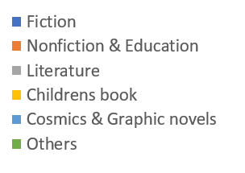
Opportunity
Projected global E-book market by 2024 reach USD $29.43 Bil
The growth would be driven by:
Technology advancement
Rising education youth
Increasing smart device penetration
Government policies
Free e-Book reader application
Notes:
https://www.hexaresearch.com/research-report/e-book-market?utm_source=Quora&utm_medium=Referral&utm_campaign=Tanuja
https://www.prnewswire.com/news-releases/e-book-market-size-to-reach-usd-2943-billion-by-2024-hexa-research-642662733.html

Slide 6

Introducing
BOOKCHAIN

Slide 7
BookChain Protocol
Solves endemic publishing problems & usability for authors and readers
1.
Transparent and immediate rewards to authors
Multi-dimensional copyright protection to avoid piracy
Incentivization of content creation
Verifiable & portable files for readers to use at their choice

Slide 8
Three Pillars of BookChain Protocol
Economics
Authors will be paid immediately without losing control to publishers
Protection
Provide multi-dimensional copyright choices for authors to have full control of their works
Efficiency
A marketplace that allow frictionless content distribution between both authors (to publish) and readers (to purchase)
BookChain Protocol
Decentralized Trusted Network

Slide 9











Authors – Secured Uploaded to BookChain
Content + Cipher
Hash
d00vc87cewaew0fd0a0
BOOKCHAIN
Decryption Key
Smart Contract

Slide 10







Consumers & Authors Completed secure transaction in 10 sec
Hash
d00vc87cewaew0fd0a0
Content + Cipher
Decryption Key
BOOKCHAIN
Token
Notes:
The token acts as a authorization key for the consumer to be able to access the decryption key and hash address
With the hash, the consumer is able to locate the encrypted content and decrypt it with the key
The consumer is now able to read the content!
The consumer is not able to share the content because it is stored on IPFS.
Even if it was shared, the other user will need to have their own private key to access the contents
The consumer A can transfer their own private key to another consumer B; however, consumer A will no longer have access to the unencrypted contents

Slide 11
Demo
https://github.com/pwx603/bookchain

Slide 12
Consideration factors
Education to facilitate adoption among authors
Marketing for consumers
Multiple download formats based on consumers preference
Digital content besides books (e.g. Music, videos)
Localization

Slide 13

Github
https://github.com/pwx603/bookchain

Slide 14
Bookchain Decentralized Blockchain Architecture
HTP Node
Decentralized Trust Network
Client Application
Public Permissioned Blockchain
Tasks Reputations Task Store Wallets
Off-Chain Data Storage
Application Logic Trust Evaluator(s)
Clients
Observer Nodes
Validator Nodes
Decentralized nodes anchor veriﬁable data on a blockchain with scalable data storage oﬀ-chain.
The trust network uses a multi-layer node approach for scalability. Validator nodes accepting write transactions and synchronize using BFT consensus. Observer nodes provide read-only requests and mainly serve reputation data
Clients access the Protocol for reputation data to help users assess trust. Trust evaluators score reputation data.

